Slide 1
Weed Detection Problem

Slide 2
Agenda
Problem Definition
Dataset
Challenges
Technologies Used
Process Diagram
Demo
Conclusion

Slide 3
Problem Definition
1

Slide 4
Problem Definition
Weeds are unwanted plants that can survive and reproduce in agricultural fields.
Removal of weed from cultivated fields during early stages of crop growth is essential for a healthy and good harvest.
For weed detection we need field photographs with good precision by attaching a camera in the front of the tractor/machine or manually.

Slide 5
Dataset
2

Slide 6
Dataset
A set of 60 photos of different fields with the same conditions that contains weed and crop in different positions:
Overlapping
Non-Overlapping
Poised Overlapping
We will use 40 photos for training our model and 20 for testing it.

Slide 7
Challenges
3

Slide 8
Challenges
Labeling
Segmentation
Manual Labeling
Feature Extraction
Hog
SIFT
Pixels
How to represent the output

Slide 9
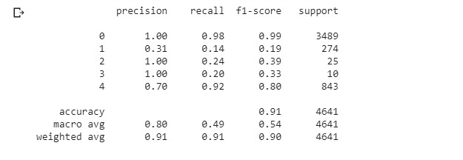

Slide 10
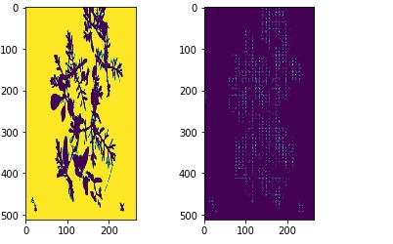

Slide 11
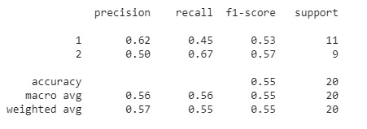

Slide 12
Technologies Used
4

Slide 13
Technologies Used
Python
OpenCV
Google Colab
TensorFlow
Scikit-image
Computer Vision(Semantic Segmentation)

Slide 14
Computer Vision
There are various levels of granularity in which the computers can gain an understanding of images.
For each of these levels there is a problem defined in the Computer Vision domain.
Starting from a coarse grained down to a more fine grained understanding, let’s describe these problems below:
Image classification
Classification with Localization
Object Detection
Semantic Segmentation
Instance segmentation

Slide 15
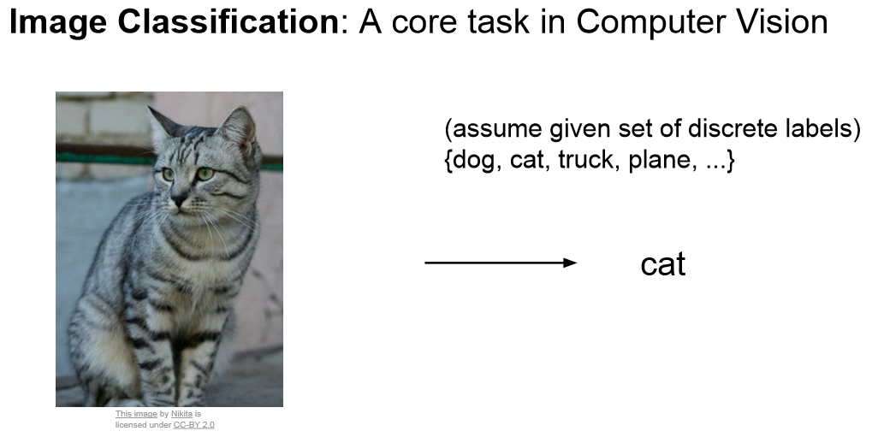
Image Classifacation
The most fundamental building block in Computer Vision
We expect the computer to output a discrete label, which is the main object in the image
In image classification we assume that there is only one (and not multiple) object in the image.

Slide 16
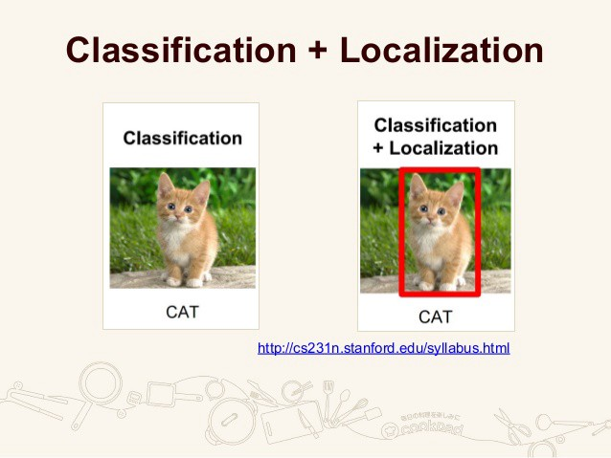
Classification With Localization
In localization along with the discrete label, we also expect the compute to localize where exactly the object is present in the image
Implemented using a bounding box which can be identified by some numerical parameters with respect to the image boundary
The assumption is to have only one object per image

Slide 17
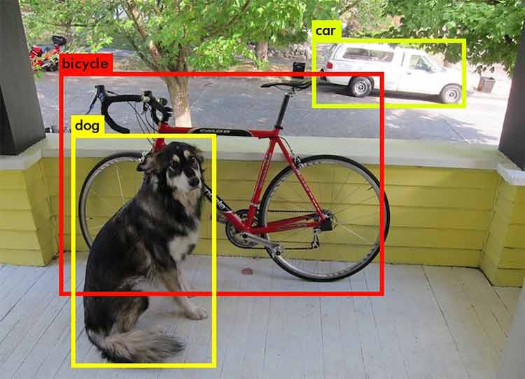
Object Detection
Extends localization to the next level where now the image is not constrained to have only one object
The task is to classify and localize all the objects in the image
The localization is done using the concept of bounding box

Slide 18
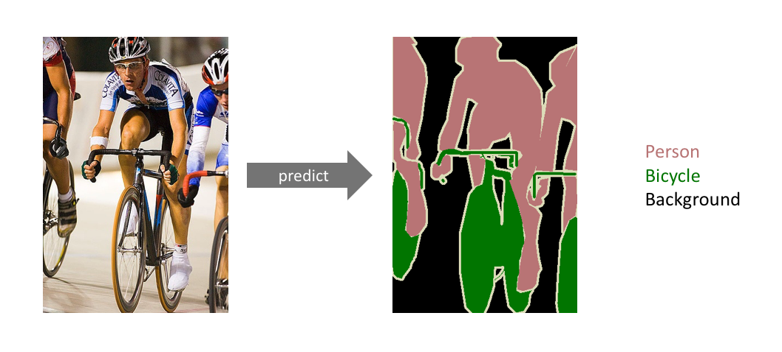
Semantic Segmentation
The goal is to label each pixel of an image with a corresponding class of what is being represented
This task is commonly referred to as dense prediction
The output itself is a high resolution image (typically of the same size as input image) in which each pixel is classified to a particular class
Thus it is a pixel level image classification.

Slide 19
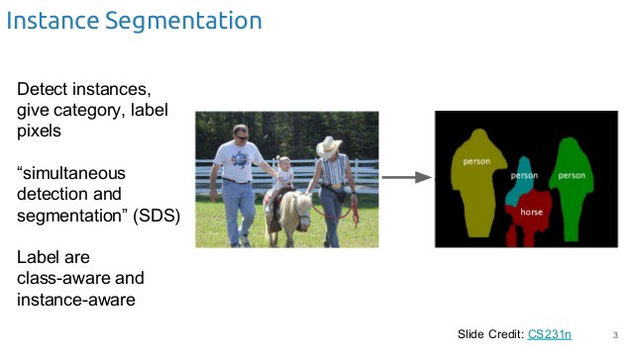
Instance Segmentation
One step ahead of semantic segmentation
The computer to classify each instance of a class separately
Semantic segmentation does not differentiate between the instances of a particular class

Slide 20
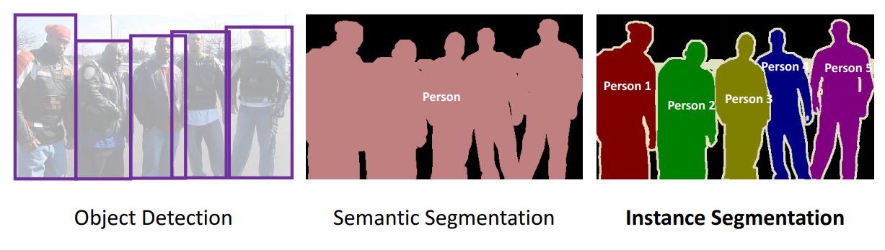

Slide 21
Process Diagram
5

Slide 22
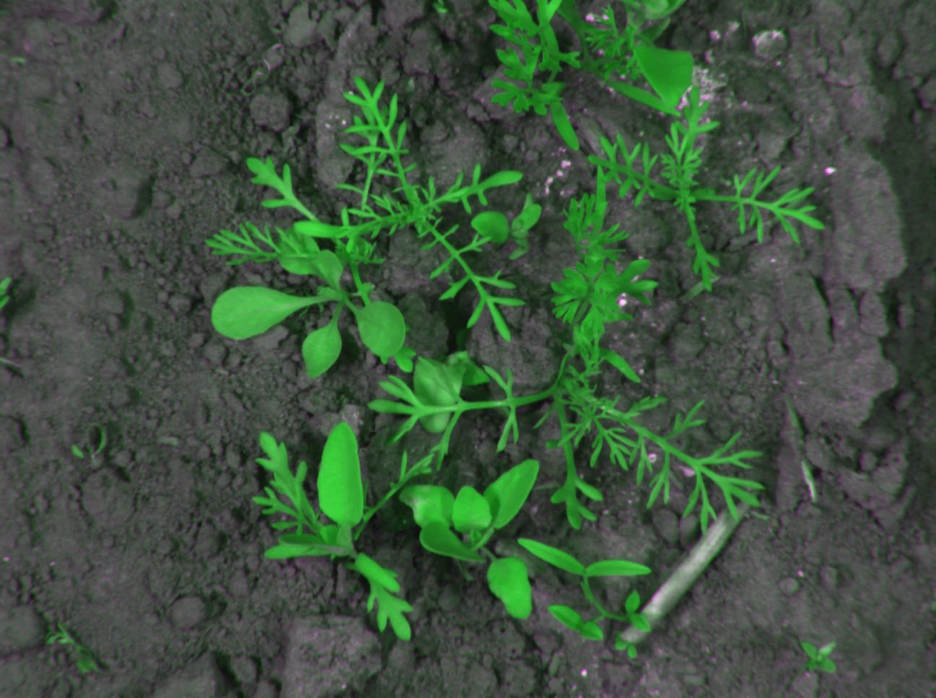
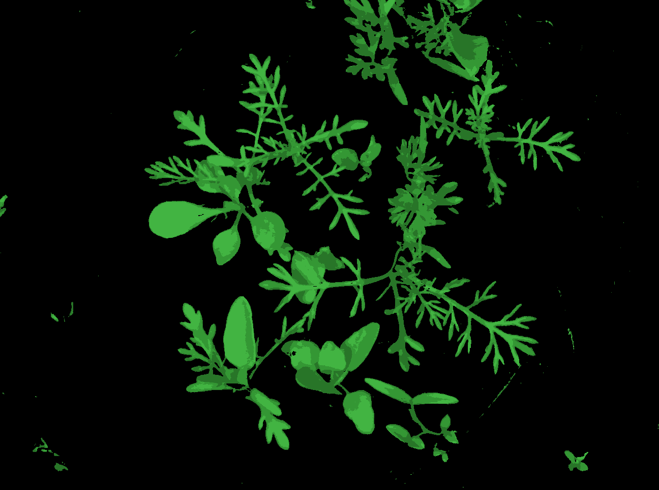
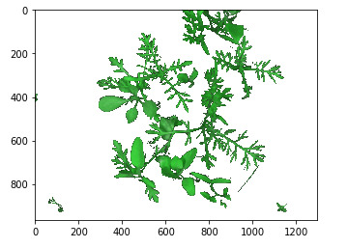
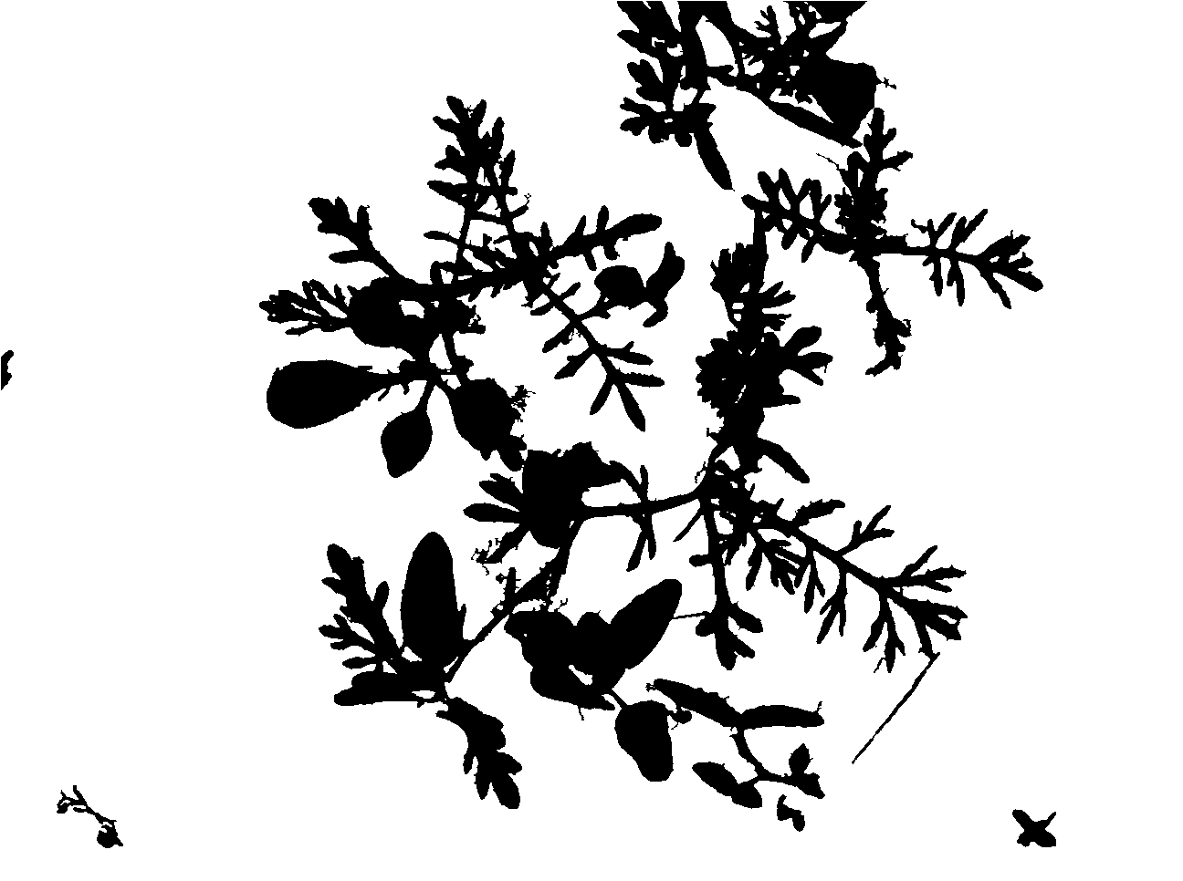
Clustering
(K-Mean)
Masking
(Morphology)
Input
Thresholding

Slide 23
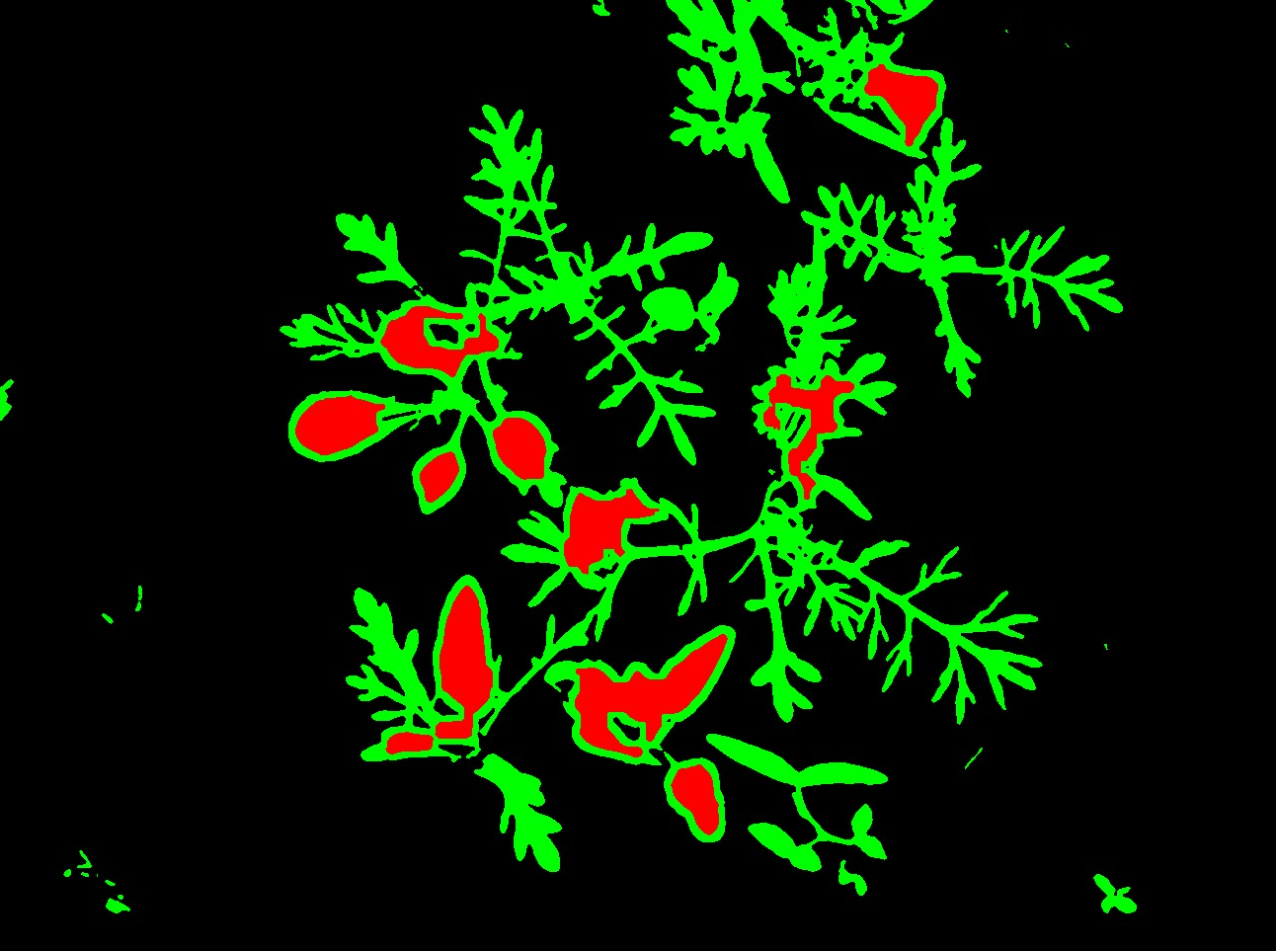
Input
Clustering
(K-Mean)
Masking
(Morphology)
Thresholding
Labeling

Slide 24
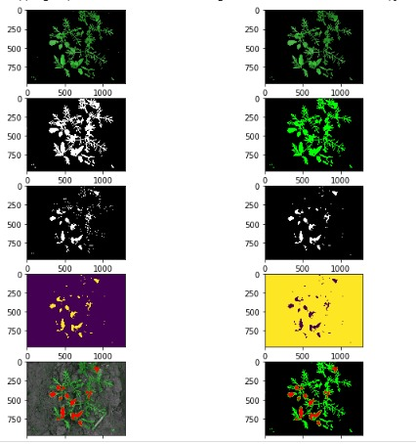
Masking
Applying Median Filter
Binarization
Morphological Operations
Finding & Drawing Contours

Slide 25
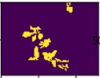
Input
Clustering
(K-Mean)
Masking
(Morphology)
Thresholding
Labeling
Augmentation
(Flipping)
Object
Separation

Slide 26
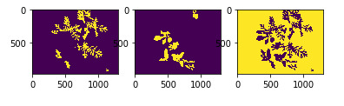
Labeling Image Depending on Color
Resizing Image
Flipping

Slide 27
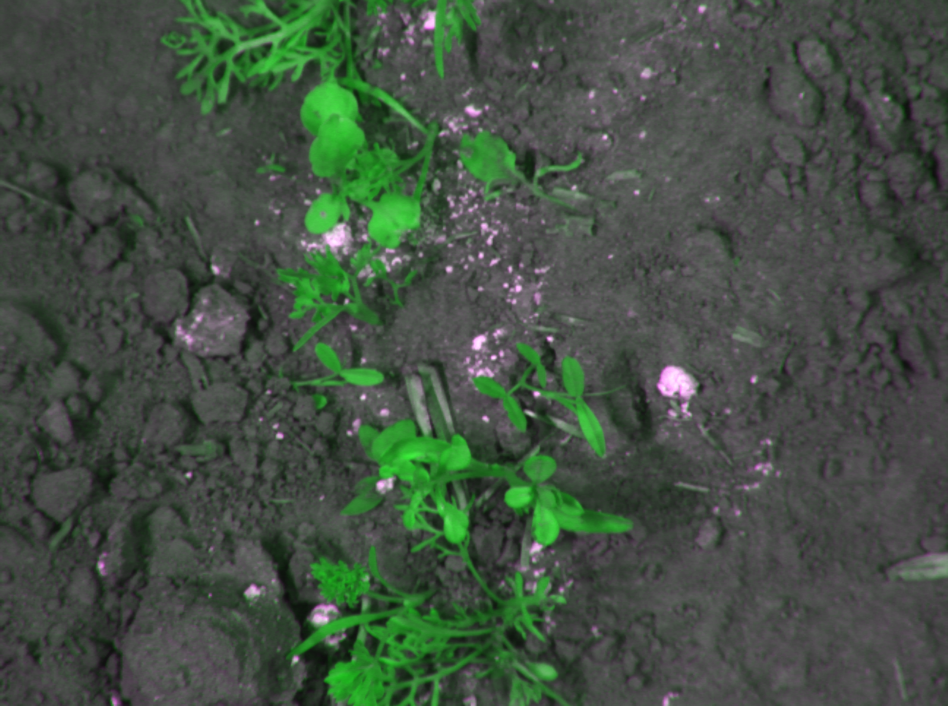
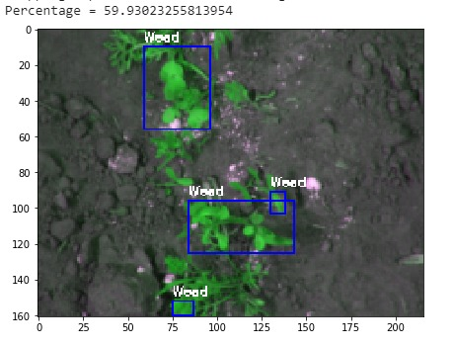
Input
Clustering
(K-Mean)
Masking
(Morphology)
Thresholding
Labeling
Creating & Train Model
(UNET)
Augmentation
(Flipping)
Object
Separation
Testing

Slide 28
Demo
6

Slide 29
Conclusion
7

Slide 30
Conclusion
Weed detected using UNET architecture (Fully Convolution Neural Network) mainly does image segmentation.
By manual labelling and Morphological Operations for images, We achieved accuracy varies from 65% to 77% depending on the overlapping of leafs and how efficient the labeling is.
Training strategy that relies on the strong use of data augmentation to use the available annotated samples more efficiently
Images that have separated weed and crop are observed with maximum accuracy while the images that include overlapping leaves have minimum accuracy for predicting weed.

Slide 31
References
https://towardsdatascience.com/understanding-semantic-segmentation-with-unet-6be4f42d4b47
https://github.com/agrawal-rohit/Weeds-Detection-and-Segmentation
https://lmb.informatik.uni-freiburg.de/people/ronneber/u-net/
https://arxiv.org/abs/1505.04597
https://docs.google.com/document/d/1yffPnYz8fYgYJVYeD-dMnylnXalV5GknPbtPAAnE6ro/edit#
https://courses.cs.washington.edu/courses/cse576/book/ch3.pdf
https://opencv-python-tutroals.readthedocs.io/en/latest/py_tutorials/py_imgproc/py_morphological_ops/py_morphological_ops.html

Slide 32
Thank You

